Slide 1


Sarvajanik College of Engineering and Technology
Subject – Cyber Security
Presented To – Prof. Jaydeep Barad
Presented By – Amul Luniya 160420107003
Priya Bhagwakar 160420107004

Slide 2


Slide 3
Index
Backdoor – Introduction
Intrusion Strategies in Backdoor attacks
List of Backdoor attacks
Chaos Backdoor
China Backdoor attack
Protection against Backdoor attacks
References

Slide 4

In literal sense…
Notes:
A backdoor is a malware type that negates normal authentication procedures to access a system. As a result, remote access is granted to resources within an application, such as databases and file servers, giving perpetrators the ability to remotely issue system commands and update malware.

Slide 5
Backdoor
A way to access a computer system or encrypted data that bypasses the system's customary security mechanisms.
An undocumented portal that allows an administrator to enter the system to troubleshoot or do upkeep.
A secret portal that hackers and intelligence agencies use to gain illicit access.
Useful to regain possession in case of theft

Slide 6
…Backdoor
Created by –
Developers
Attackers –
Detect the backdoor themselves
Install a backdoor themselves
Use a worm or virus to take the advantage of backdoor created in an earlier attack

Slide 7
Intrusion Strategies in Backdoor Attacks
Port binding
Connect-back
Connect availability use
Legitimate platform abuse
Common services protocol abuse
Protocol or port listening
Custom DNS lookup use

Slide 8
List of backdoor attacks
Chaos backdoor
China’s backdoor
Back Orifice Backdoor
The ProFTPD backdoor
The DSL backdoor – in modems
The PGP full-disk encryption backdoor.
WordPress plugins backdoor
The Borland Interbase backdoor – an RDBMS server

Slide 9
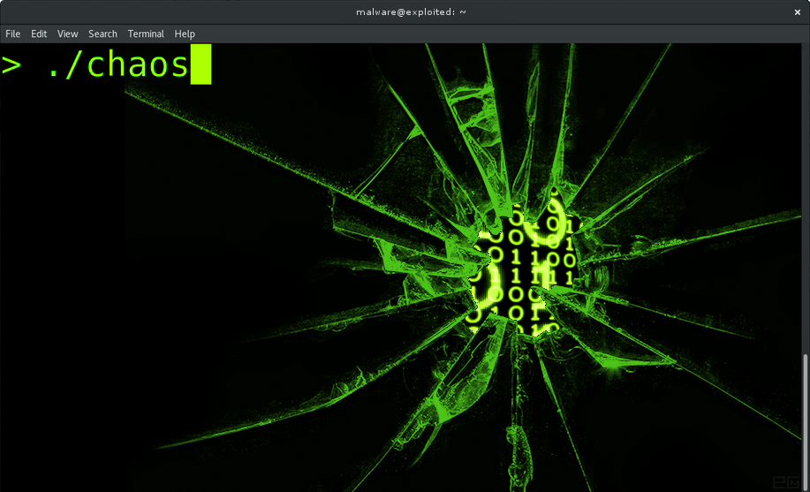
The Chaos Backdoor

Slide 10
Chaos Backdoor
Chaos is a backdoor trojan that was originally part of the "sebd" rootkit active around 2013.
The attacker downloads a file appended with .jpg to appear as a JPG file for a sense of legitimacy when, in fact, it is actually a .tar archive.

Slide 11
Chaos Backdoor
The archive contains the following:
Chaos - ELF executable
Client - ELF executable
initrunlevels - Shell script
install - Shell script

Slide 12
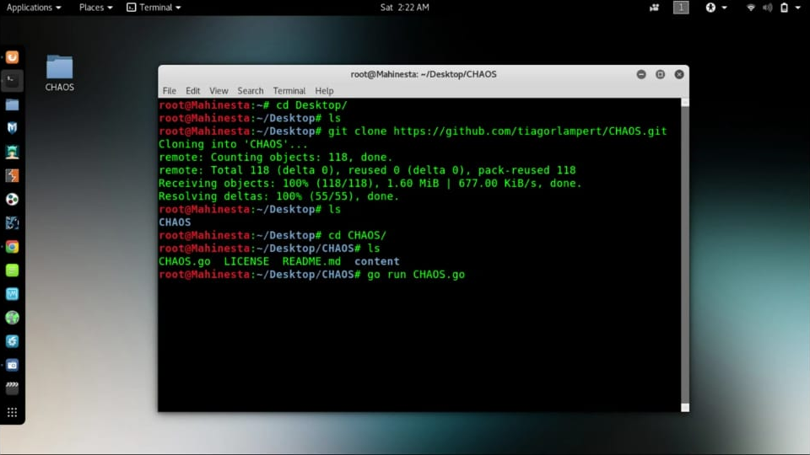
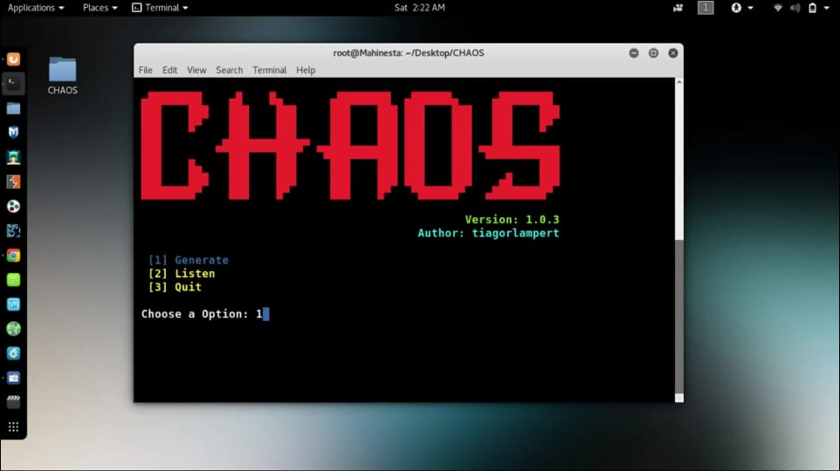

Slide 13
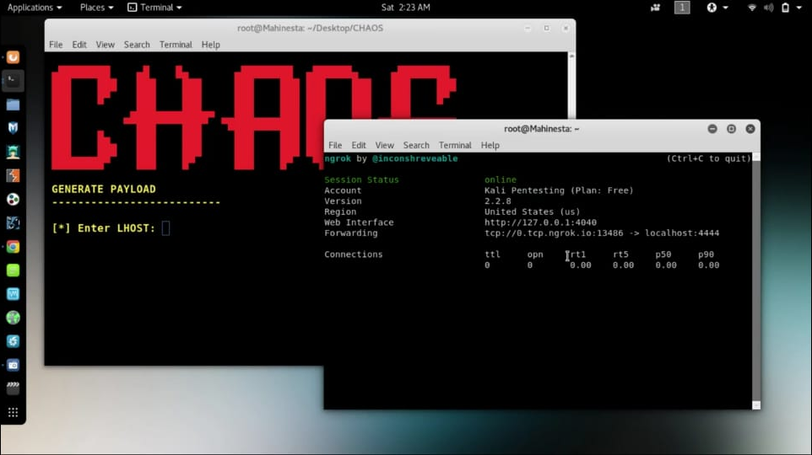
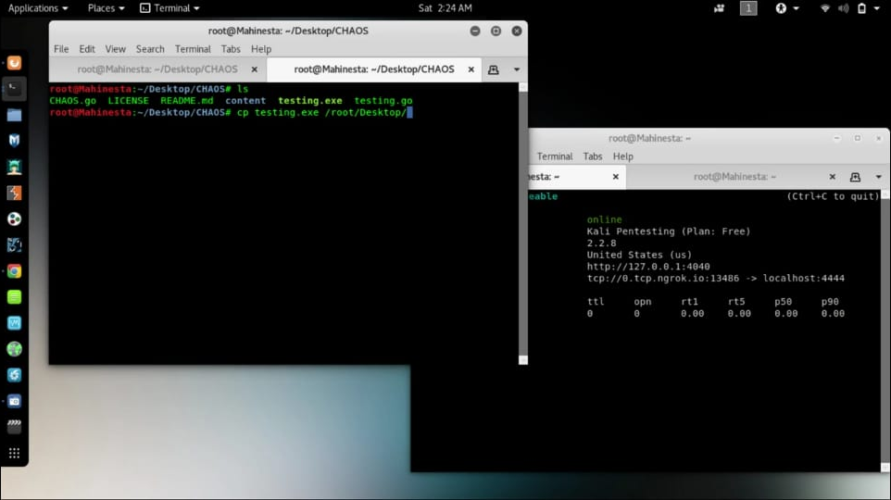

Slide 14
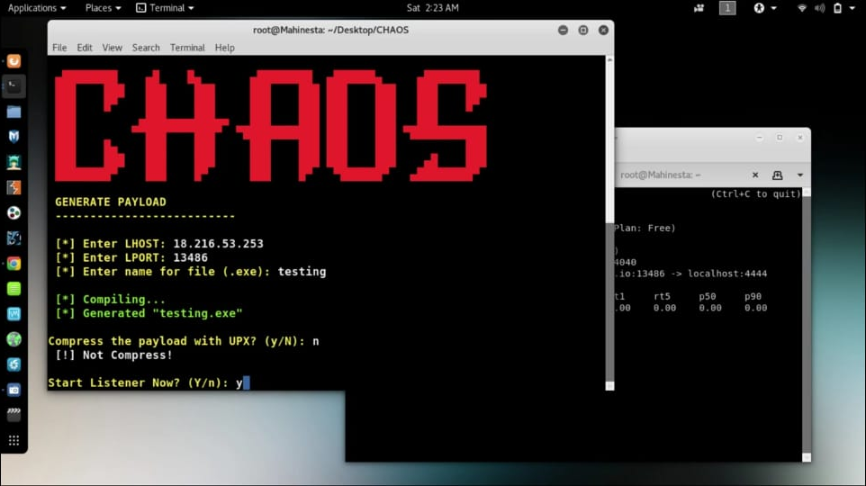
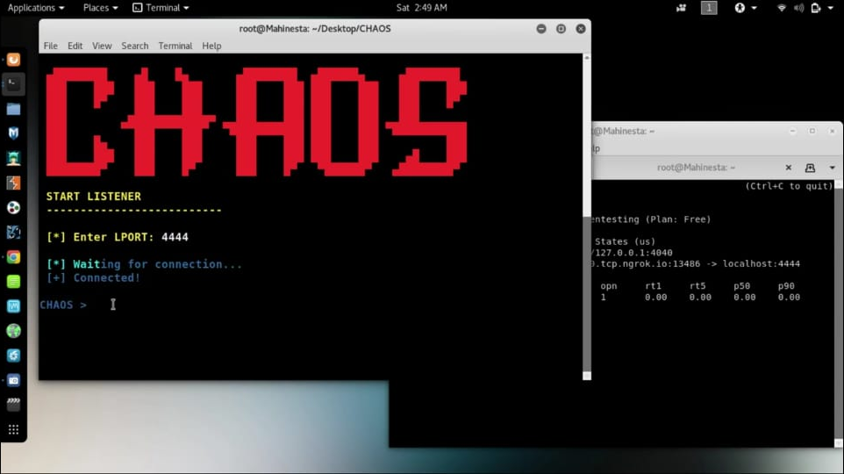

Slide 15
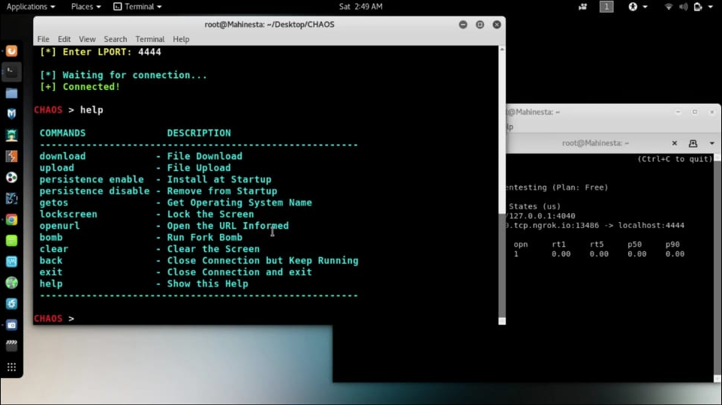

Slide 16
China’s Backdoor Attack

Slide 17


Slide 18
…China’s Backdoor attack
Chinese hackers 'built back door hack into software to spy on Britain’s top businesses‘
APT15 – Chinese cyber espionage group
NetSarang – the program’s update which retained the backdoor.

Slide 19
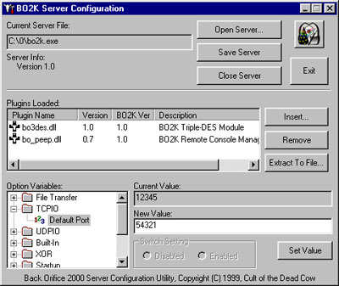
Back Orifice
A computer program designed for remote system administration.
Notes:
Enables a user to control a computer running the Microsoft Windows operating system from a remote location.

Slide 20
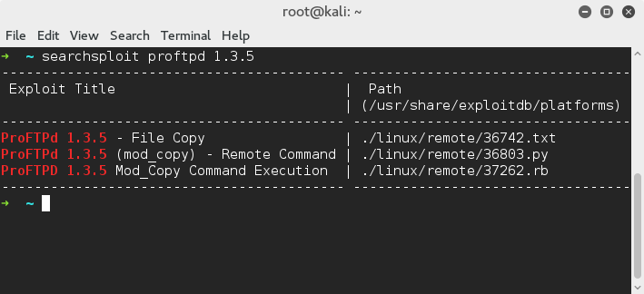
ProFTPD Backdoor
FTP server written for use on Unix
Free open source software

Slide 21
Protection against Backdoors
Firewalls
Robust network monitoring
Use of anti-malware solution – Trend Micro OfficeScan
Proper open source application selection
Protecting C&C server

Slide 22
References
www.images.google.com
https://www.cyber.nj.gov/threat-profiles/trojan-variants/chaos
www.securityaffairs.co
https://www.express.co.uk/news/world/842200/China-hackers-cyber-spying-attack-UK-business
https://www.theregister.co.uk/2017/08/15/netsarang_software_backdoor/
https://blog.trendmicro.com/backdoor-attacks-work-protect/

Slide 23

Thank You

